Slide 1
Online Photographer Hiring System
Prepared By:
Manish Desai
240160510008

Slide 2
Introduction
Looking for the perfect photographer for your event? Whether it’s a wedding, birthday, corporate event, or any special occasion, makes it easy to find and hire professional photographers online.
With just a few clicks, you can browse profiles, check availability, view portfolios, and book a photographer that fits your style and budget.

Slide 3
Existing system
Many current platforms have high pricing without clear breakdowns, making it hard for users to know if they’re getting a good deal. These systems are often not user-friendly, which makes booking a photographer confusing or time-consuming.
Also, users usually don’t get to see the actual photos that were delivered to previous clients – they only see the ones the photographer chooses to post. This makes it hard to decide which photographer is truly the best for their event.
Photographer hiring website:
POD,BookMyShort,OPICXO,vsnapu,etc.

Slide 4
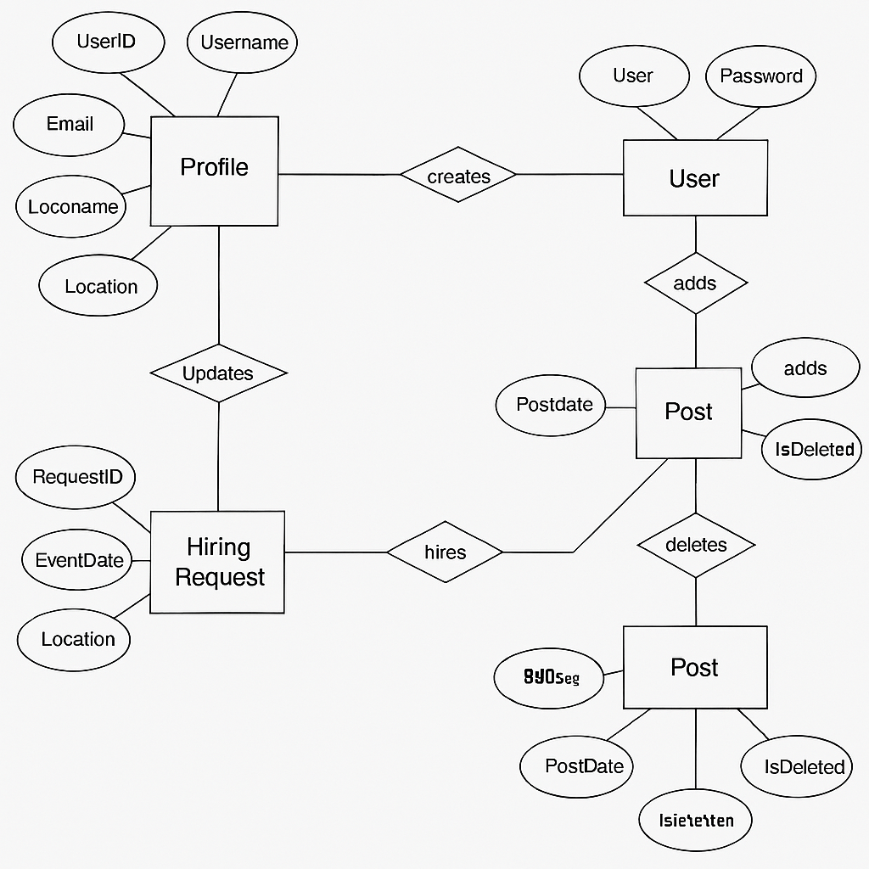
ER Diagram:
Deletes
category
Admin
Block
Block
location

Slide 5
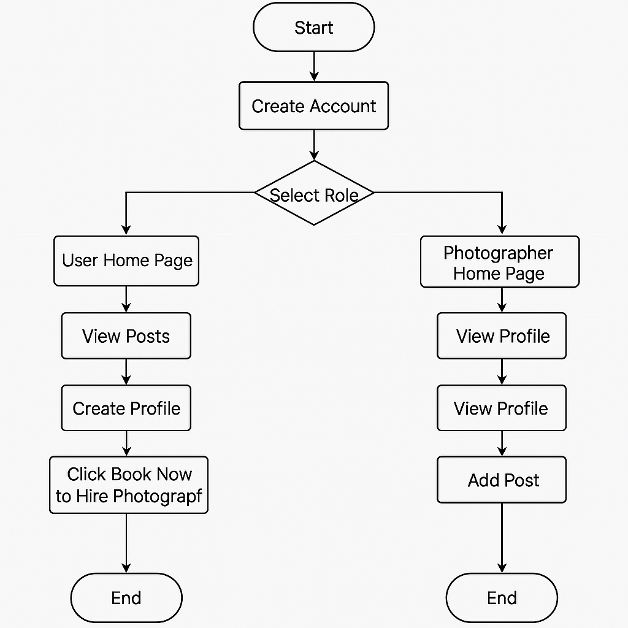
Activity Diagram
Create account
Select Role
User Home page
Photographer Home page
View Posts
View Post
View Profile
View Profile
Create Profile
Create Profile
Hire Photographer
Hire Photographer
Add Post

Slide 6
New system
The platform will serve as an online marketplace where users (clients) can create accounts, view photographer profiles, and book photographers for events. Photographers can create accounts, manage their profiles, upload photos, and offer their services for booking.

Slide 7
Data Flow Diagram 0 level
Online Photographer Hiring System
Admin
Request
Request
User
Response
Response

Slide 8
Level 1
Admin
1.0
Registration
Request detail
User
Response
Response
Store Detail
Admin_login
Response
u_registration
match detail
Request
2.0
Login
match detail
response
Response
Response
Request match detail
Request
Operation request
u_registration
3.0
User operation
Response
Request
post
Response
Request
Response
Response
Request
Hiring_request
Response
4.0
Admin Operation
Request
Block_user
Operation Request
Response
Response

Slide 9
Level 2
User
Post detail
Add post
post
3.1
Add post
Display post
response
Book
3.2
Hiring Photographer
book
Hiring_request
response
response
Update profile
update
3.3
Update Profile
successfully
response
Delete post
3.4
Delete post
Successfully delete
u_registration
Delete psot
3.5
Logout
response
Logout request
Logout successfully

Slide 10
Level 2
Admin
Block user
Request to block
U_registration
4.1
block user
Successfully block
response
Delete post
4.2
Delete post
Delete psot
Successfully delete
post
response
Logout request
4.3
logout
Logout successfully

Slide 11
Use case
User Admin
Login
View profile
Update profile
Add post
Delete post
Book photographer
logout
Login
Block user
Delete post
logout

Slide 12
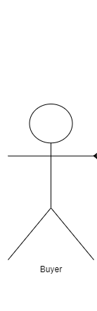
Use case Diagram :User
Login
View profile
Update profile
Add post
Delete post
User
Hiring photographer
logout

Slide 13
Use case Diagram :Admin
Login
Block user
Delete post
Admin
logout

Slide 14
Data Dictionary :
Admin : (AdminID (PK),Username,Password,Image)
User: ( UserID (PK),Username,Password,Email,MobileNo,Gender,Role (Photographer / Client),Image)
Post : (PostID (PK),UserID (FK → User),Title,Description,Image,Date,IsDeleted )
HiringRequest : (RequestID (PK) ClientID (FK → User),PhotographerID ,EventDate,Location,Budget,Status (Pending / Accepted / Completed))
BlockUser: (BlockID (PK),AdminID (FK → Admin),UserID (FK → User), BlockDate)

Slide 15
Thank you

